Slide 1

-------------------------------------------------------------------------------------------------------------------
ADA BOOST
ADA BOOST

Slide 2
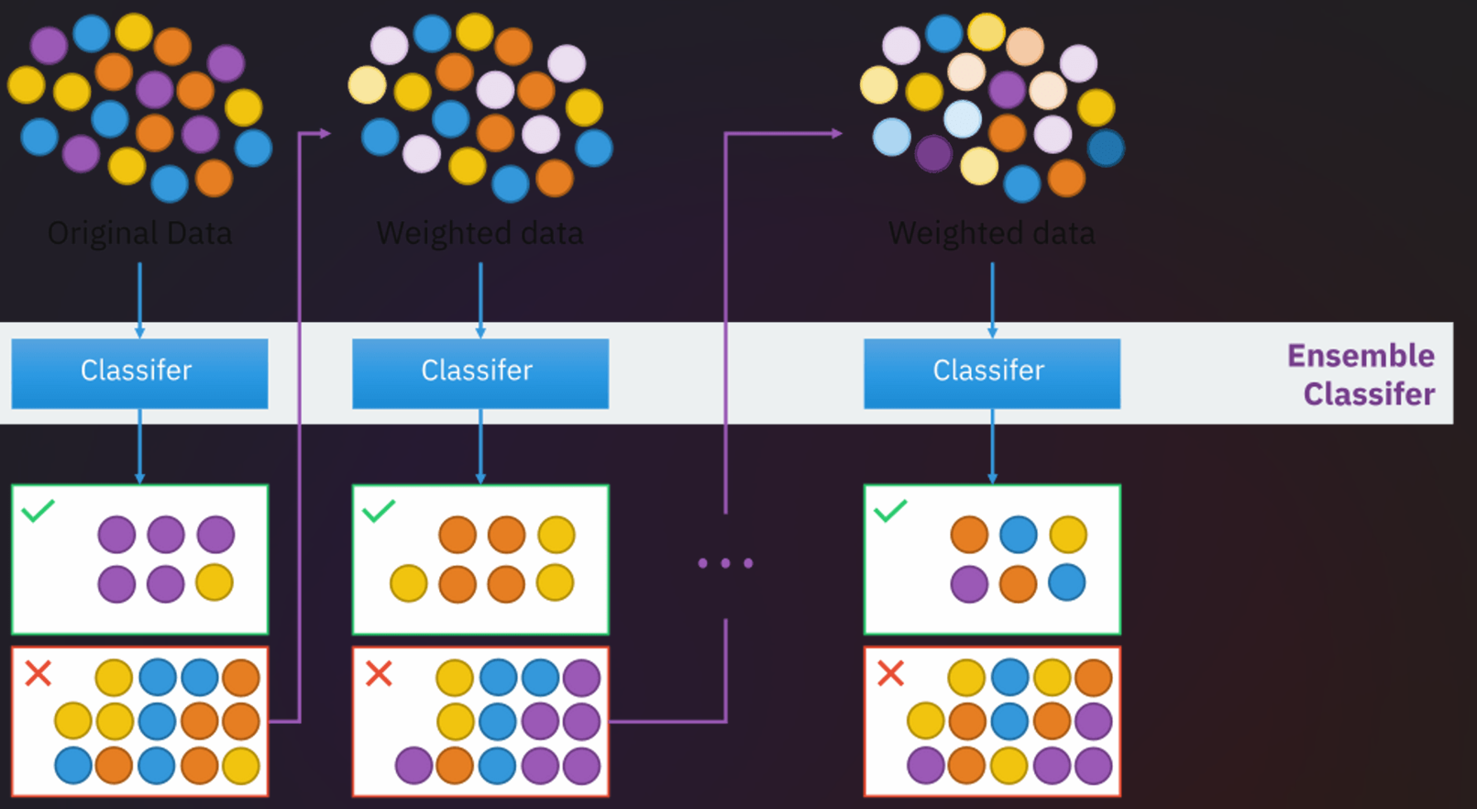
AdaBoost is a boosting algorithm that also works on the principle of the stagewise addition method where multiple weak learners are used for getting strong learners. The value of the alpha parameter, in this case, will be indirectly proportional to the error of the weak learner, Unlike Gradient Boosting in XGBoost, the alpha parameter calculated is related to the errors of the weak learner, here the value of the alpha parameter will be indirectly proportional to the error of weak leaner.

Slide 3
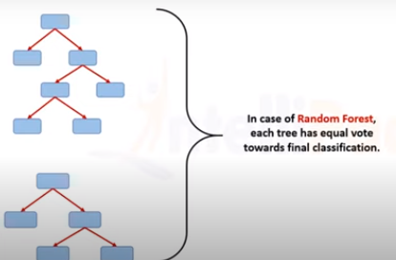
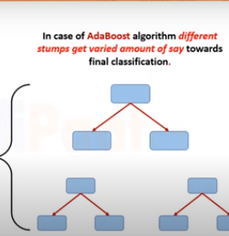
Random forest vs ada boost

Slide 4
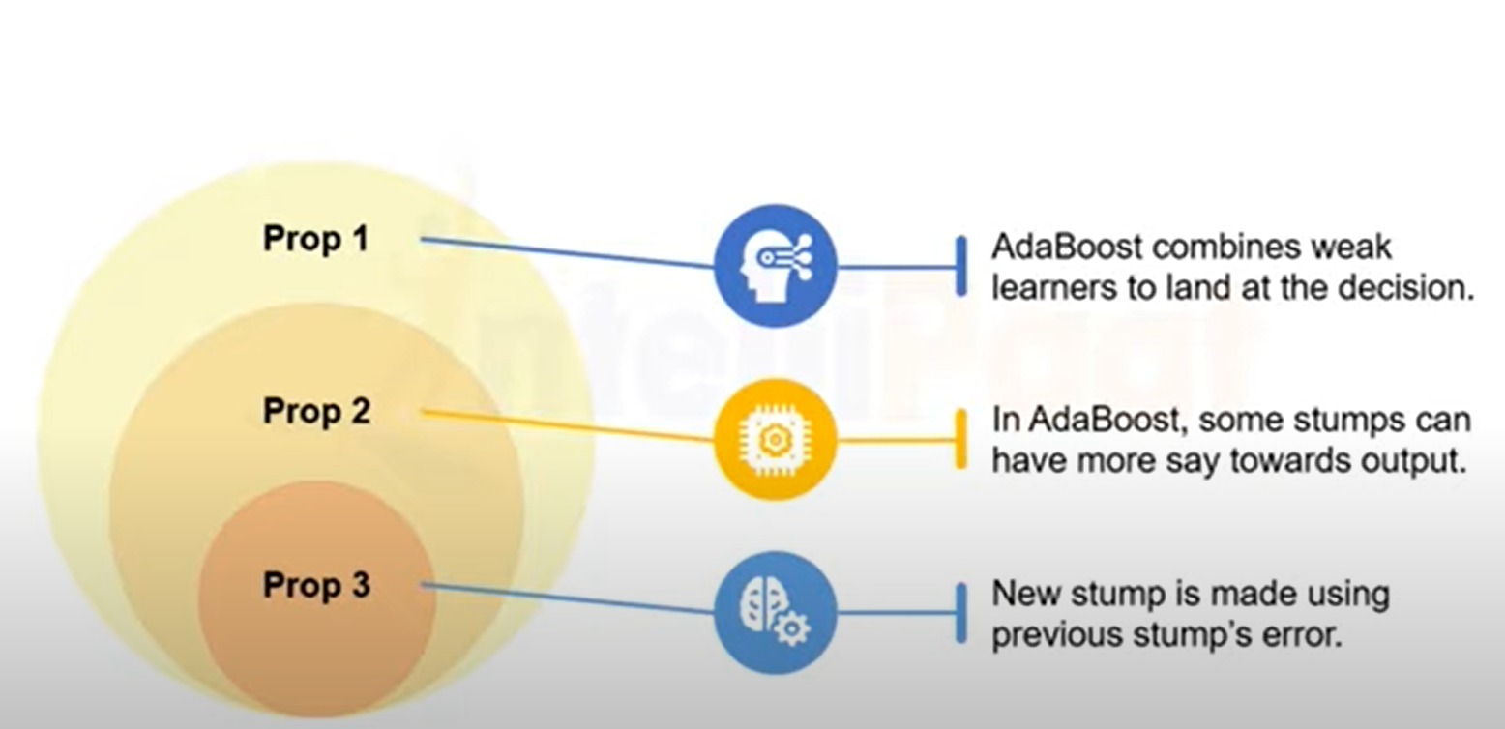

Slide 5
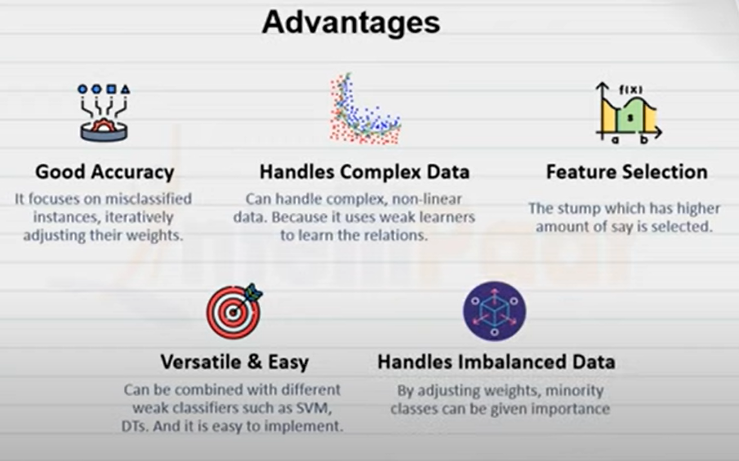

Slide 6
Thank you

